Slide 1
CRISIS AND EMERGENCY RISK COMMUNICATION Basic Course
Be First. Be Right. Be Credible.

Slide 2
Instructors
Molly Gaines-McCollom, MPH, CHES
Nikki Grimsley, CHES

Slide 3
Purpose
CERC principles can help you provide the public with information to make the best decisions within incredibly challenging time constraints and to accept the imperfect nature of choice

Slide 4
Learning Objectives
Describe CERC principles
Explain how communication and risk perception are different during a crisis
Explain how audiences judge messages and how to tailor messages
Describe why crisis communication plans are important
Explain the spokesperson’s and media’s roles during a crisis in addition to how to work with and respond to the media
Describe the benefits of social media and mobile media devices

Slide 5
Introduction to CERC

Slide 6
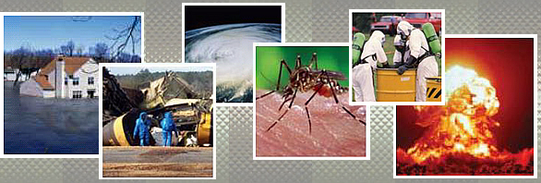
Common Types of Hazards
Bioterrorism
Chemical and radiation exposures
Infectious disease outbreaks
Natural disasters and severe weather
Explosions

Slide 7
Increased Risks
Population density in high-risk areas
Technology
Aging population
Emerging infectious diseases
International travel
Terrorism

Slide 8
Scenario
Five hours ago your community suffered a catastrophic chemical explosion.
Three workers at the chemical plant are known to be dead.
Seventeen are still unaccounted for.
Residents in a 5-mile radius were evacuated
Evacuees are staying in American Red Cross shelters until they can return home.
There has been an increase of medical clinic and emergency room visits in the surrounding communities and counties. Mothers are reporting more skin rashes on children.
The cause of the explosion is unknown, but terrorism is suspected.

Slide 9
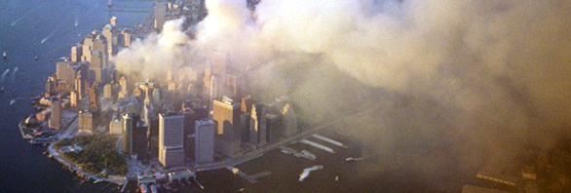
Communication in Emergencies
In a catastrophic event, communication is different
Affected people:
Take in information differently
Process information differently
Act on information differently

Slide 10
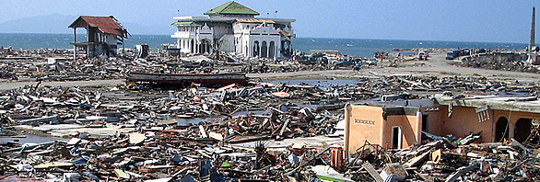
Communicating During a Public Health Crisis

Slide 11
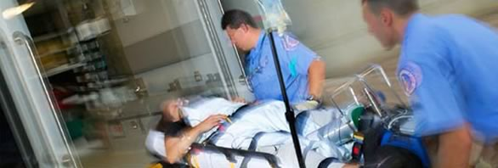
Six Principles of CERC
Be First
Crises are time-sensitive

Slide 12
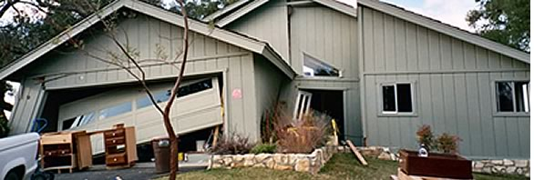
Six Principles of CERC
Be Right
Accuracy establishes credibility
Information should include what is known, what is not known, and what is being done to fill in the gaps

Slide 13
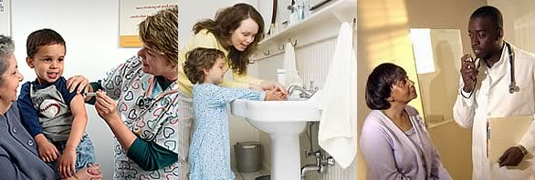
Six Principles of CERC
Be Credible
Honesty should not be compromised

Slide 14
Six Principles of CERC
Express Empathy
Suffering should be acknowledged in words
Builds trust and rapport

Slide 15
Exercise: Sympathy or Empathy?
1. Our hearts and prayers go out to the victims of this flood.

Slide 16
Exercise: Sympathy or Empathy?
2. During times like these, all of us feel a little uncertain about the future.

Slide 17
Exercise: Sympathy or Empathy?
3. How frustrating this must be after you thought the worst was over.

Slide 18
Exercise: Sympathy or Empathy?
4. These are frightening circumstances and I understand any reluctance there may be to try this new remedy.

Slide 19
Exercise: Sympathy or Empathy?
5. Remember that we care about you.

Slide 20
Exercise: Sympathy or Empathy?
6. We are thinking of you during this difficult time.

Slide 21
Exercise: Expression of Empathy
Five hours ago your community suffered a catastrophic chemical explosion.
Three workers at the chemical plant are known to be dead.
Seventeen are still unaccounted for.
Residents in a 5-mile radius were evacuated
Evacuees are staying in American Red Cross shelters until they can return home.
There has been an increase of medical clinic and emergency room visits in the surrounding communities and counties. Mothers are reporting more skin rashes on children.
The cause of the explosion is unknown, but terrorism is suspected.

Slide 22
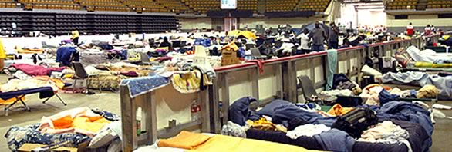
Six Principles of CERC
Promote Action
Calms anxiety
Promotes a restored sense of control

Slide 23
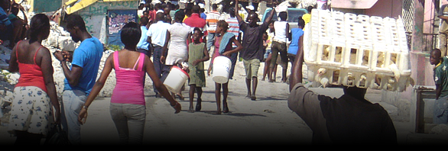
Six Principles of CERC
Show Respect
Important when people feel vulnerable
Promotes cooperation and rapport

Slide 24
Crisis Communication Lifecycle
Prepare
Foster alliances

Slide 25
Initial Phase
Empathy
Explain the risk
Establish credibility
Provide emergency courses of action
Commit to public communication

Slide 26
Maintenance Phase
Help the public understand its own risks
Listen to feedback
Empower risk/benefit decision-making

Slide 27
Resolution Phase
Educate public for future crises
Gain support
Promote your organization’s role

Slide 28
Evaluation Phase
Evaluate communication plan performance
Return to pre-crisis planning

Slide 29
Psychology of a crisis

Slide 30
Psychological Barriers

Slide 31
Psychological Effects of a Crisis
Negative vicarious rehearsal
Hopelessness
Helplessness
Optimistic bias
Stigmatization

Slide 32
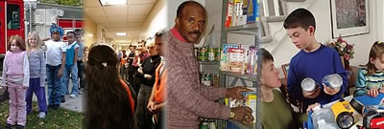
Panic Myth

Slide 33
Hazard and Outrage Differences & Principles
Hazard: Scientific measure
Outrage: Emotional measure
Risk = Hazard + Outrage

Slide 34
Exercise: Hazard and Outrage
Pandemic influenza in the United States
Bioterrorism attack with plague in the United States
Pertussis outbreak in an elementary school
Hepatitis A outbreak among children resulting from their eating illegally imported strawberries as a part of a USDA-supported school lunch

Slide 35
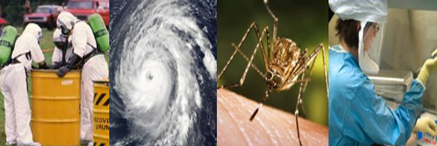
Risk Perception
Risks are not accepted equally

Slide 36
CERC in Action
Allow people the right to feel fear
Don’t over-reassure
Acknowledge uncertainty
Give people meaningful things to do
Under-promise and over-deliver
When the news is good, state continued concern before stating reassuring updates

Slide 37
Messages and audiences

Slide 38
Understanding Your Audience
The public will judge your message by its content, messenger, and method of delivery

Slide 39
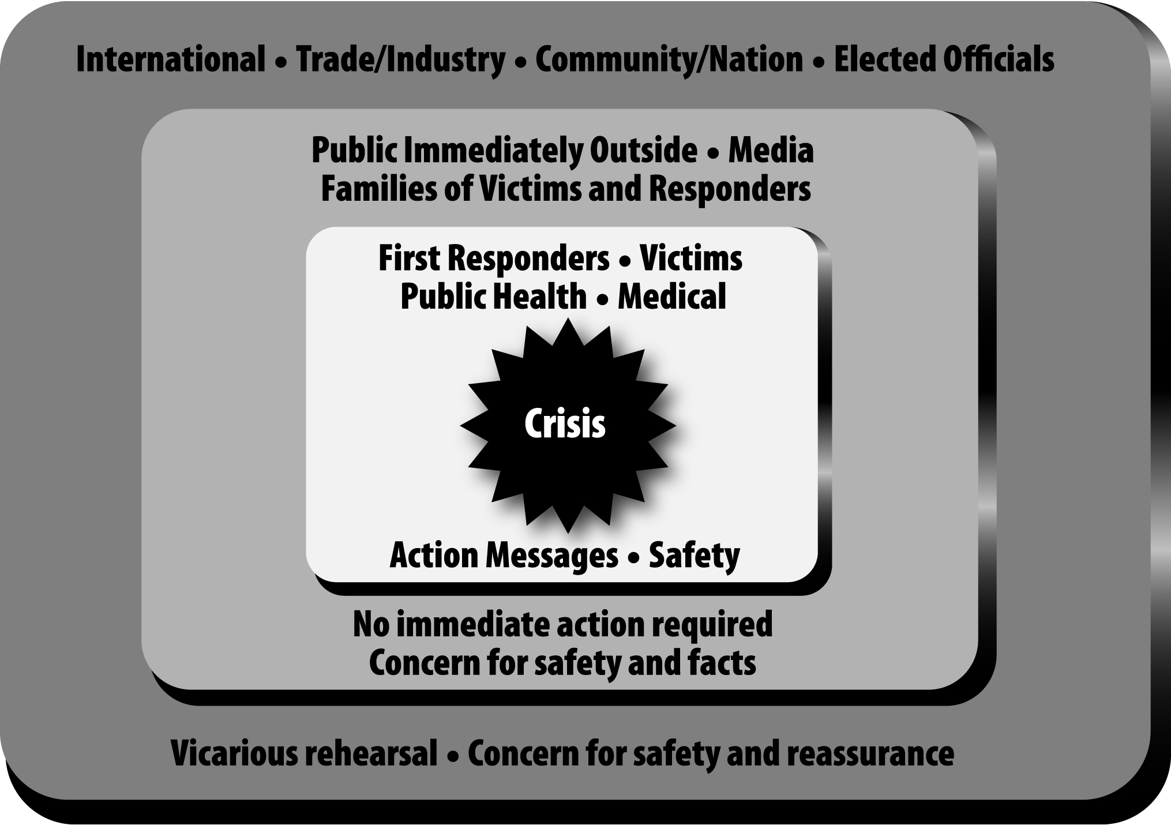
Audience Relationship to the Event

Slide 40
Accuracy of
Information
Speed of Release
CREDIBILITY
=
Successful Communication
+
Empathy
Openness
TRUST

Slide 41
Making Facts Work in Your Message
Be concise and focused
Give action steps in positives
Repeat the message
Use personal pronouns when discussing the organization
Promise only what can be delivered
Use plain language
Avoid speculation
Avoid humor

Slide 42
Exercise: Talking Points
Five hours ago your community suffered a catastrophic chemical explosion.
Three workers at the chemical plant are known to be dead.
Seventeen are still unaccounted for.
Residents in a 5-mile radius were evacuated
Evacuees are staying in American Red Cross shelters until they can return home.
There has been an increase of medical clinic and emergency room visits in the surrounding communities and counties. Mothers are reporting more skin rashes on children.
The cause of the explosion is unknown, but terrorism is suspected.

Slide 43
Crisis Communication Plans

Slide 44
Crisis Phases
Factors that can vary progression through the phases:
Event that triggered or initiated crisis
Level of harm
Adequacy of response
Community resilience
Crisis intensity and longevity

Slide 45
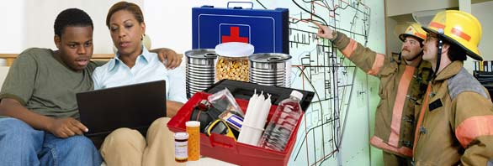
Importance of Communication
Integrate communication plans with overall emergency response plan
Don’t let communication be treated as secondary concern
Response plan will not work if not effectively communicated

Slide 46
Developing the Plan
Be realistic
Account for worst-case scenarios
Know what to include
Use the plan as a resource for “go to” and “must have” information
Keep plan current

Slide 47
First 24 - 48 Hours Planning
Be first. Be right. Be credible.
Verify the magnitude of the event
Notification and coordination
Initial media response
Initial evaluation

Slide 48
Throughout the Response
Verify the situation
Conduct notifications
Conduct crisis assessment (activate crisis plan)
Organize assignments quickly
Prepare information and obtain approvals
Release information through prearranged channels
Obtain feedback and conduct crisis evaluation
Conduct public education
Monitor events

Slide 49
The Spokesperson

Slide 50
Role of the Spokesperson
Communicates the who, what, where, when, why, and how
Removes psychological barriers
Empowers people
Takes your organization from an “it” to a “we”
Builds trust and credibility

Slide 51
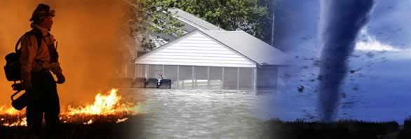
What Makes a Good Spokesperson?

Slide 52
Tips for Success
Limit jargon and acronyms
Tailor messages to make them easy to understand
Use humor with caution, or not at all
Refute negative allegations without repeating them
Gather feedback
Avoid one-liners, clichés, and off-the-cuff comments

Slide 53
Rules of Risk Communication
Accept and involve the public as a legitimate partner
Listen to your audiences
Be honest, frank, and open
Coordinate and collaborate with other credible sources
Meet the needs of the media
Speak clearly, with compassion and empathy
Plan carefully and evaluate performance
Adapted from the EPA’s Seven Cardinal Rules of Risk

Slide 54
Media and social media

Slide 55
The Media’s Role
Inform the public
Provide updates
Direct the public to information
Serve as a watchdog

Slide 56
Building Positive Media Relationships
Provide equal access to information
Give reporters what they need

Slide 57
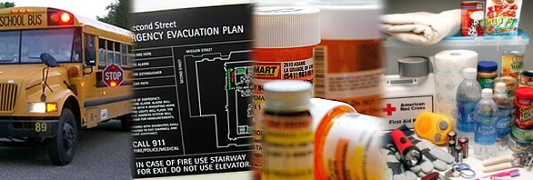
Media Operations During a Crisis
Media may react differently during an emergency!

Slide 58
Importance of Social Media
Play a critical role in informing or misinforming
Often the first publicly provided material
Source for traditional media
Allow the public to be receivers and senders

Slide 59
Using Social Media
Use all 6 CERC basic principles
Establish trust with users
Use various media
Collaborate with credible sources
Partner with the public
Remember: You can’t control every message being sent or every response to your messages

Slide 60
Mobile Media’s Role During a Crisis
Information sharing and alerts
Real-time coverage
Communication with family and friends
Directions away from disaster areas

Slide 61
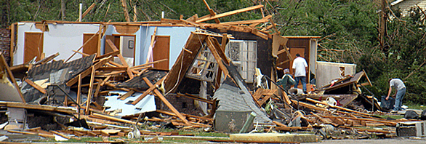
Closing
What experiences have you had or anticipate having in your career in which CERC principles would be relevant?

Slide 62
Resources
CERC Website
http://emergency.cdc.gov/cerc/
Additional Inquiries
cercrequest@cdc.gov

